Slide 1

Industry Collaborations
Part One: Finding A Partner

Slide 2

The Goal of Industry/Academic Collaboration
  Accelerate basic science discoveries to product introduction
  Provide a valuable learning experience for students

Slide 3

Academics Provide:
  Technical experience
  Problem-solving abilities

Slide 4
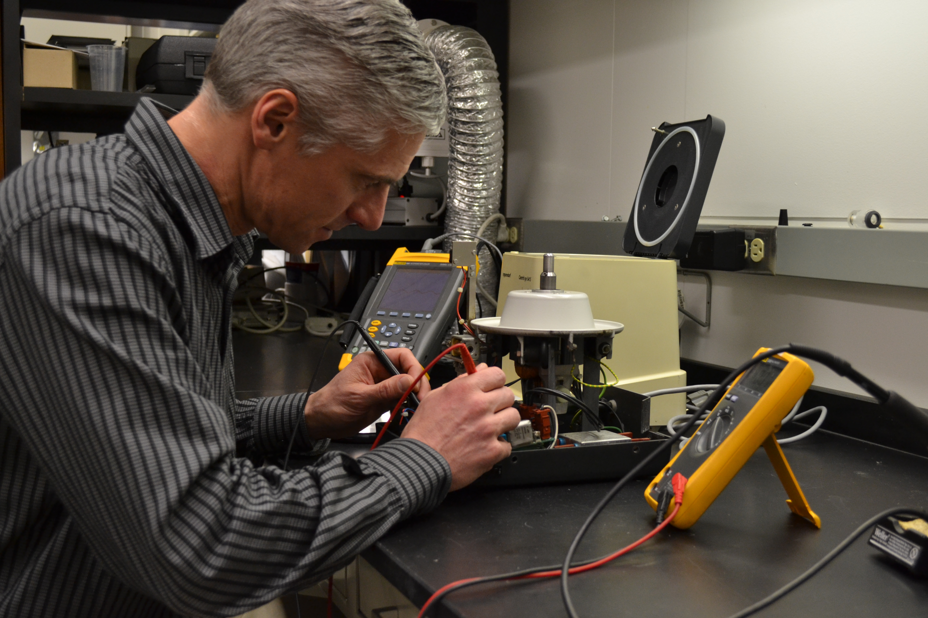
Industry Provides:
  Hands-on experience
  Production, Design, Marketing, Sales &
  Product Roll-out

Slide 5



Industry/Academic Collaborations:

Slide 6
Industry/Academic Collaborations:
  Past Experience with the Institution
  Research Facilities Related to their Product or Service

Slide 7
Industry/Academic Collaborations:

Slide 8
Industry/Academic Collaborations:
What YOU Can Do…
  Read Industry Publications
  Contact Scientists at Companies in Your Area of Research
  Attend Trade Shows
  Present Your Research in a Poster or Talk
  Seek Out Industry Representatives
  Share Your Information
  Attend Social Events
  Volunteer
  Network with Colleagues
  Use Social Media
  Keep In Touch with Your Students After They Graduate

Slide 9
The Educational and
Open Nature of Academic Research
vs.
Companies Profit Motives and
Need to Protect Proprietary Information

Slide 10
Academic Research Focuses on
Long-term Challenges, Moving More Slowly
vs.
Corporate Research & Development is
Time-sensitive, Market-driven and Daily Problem Solving

Slide 11
Industry Driven = Need to Solve a Problem
vs.
Academic Driven = Thirst for Knowledge

Slide 12
Produced by the Clinical & Translation Science Institute of Southeast Wisconsin
with special thanks to:
Katherine Durben – Marquette University
Laura Savatski – BloodCenter of Wisconsin
Jessica Silvaggi – UW-Milwaukee Research Foundation
Kalpa Vithalani – Medical College of Wisconsin

Slide 13
Produced by the Clinical & Translation Science Institute of Southeast Wisconsin
with special thanks to:

